Slide 1
Bitcoin Closing Price Predictions
Ethan Vanlerberghe
MSDS 422: Practical Machine Learning
Professor Chaturvedi
December 8, 2024

Slide 2
Agenda
Hello and welcome! In this meeting, we will cover:
Business Understanding
Exploratory Data Analysis
Methodology & Tools
Model Evaluation
Findings & Conclusions
Lessons Learned and Recommendations

Slide 3
Project Overview
Goal: Provide insights to drive financial performance for the end user.
Recently, Cryptocurrency has been a major topic in the tech world
Low regulation
High potential earnings
One has jumped out above the rest: Bitcoin Released in 2008
Currently valued at over $90,000 per coin
Quickly approaching the $100,000 mark
What if investors had an inkling every morning of which way the value would go?
Enter: Bitcoin Closing Price Predictions
Utilizing practical machine learning techniques to assist investors in decision making

Slide 4
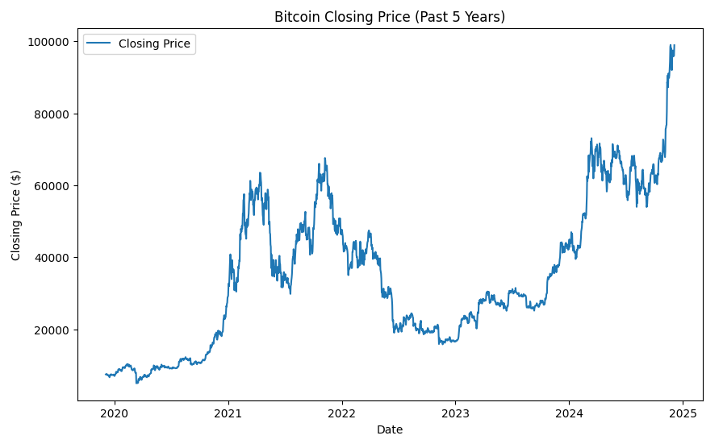
Business Understanding
Bitcoin’s beginning
Founded in 2008 by anonymous developer (Or developers) known as ‘Satoshi Nakamoto’
Quickly became the de-facto Cryptocurrency
Rapid climb during COVID-19 Epidemic
During the mass quarantines from 2020-2022, Cryptocurrency became very popular
Lead to a rapid increase in value for Bitcoin, attracting new investors
Has the potential to continue to grow rapidly

Slide 5
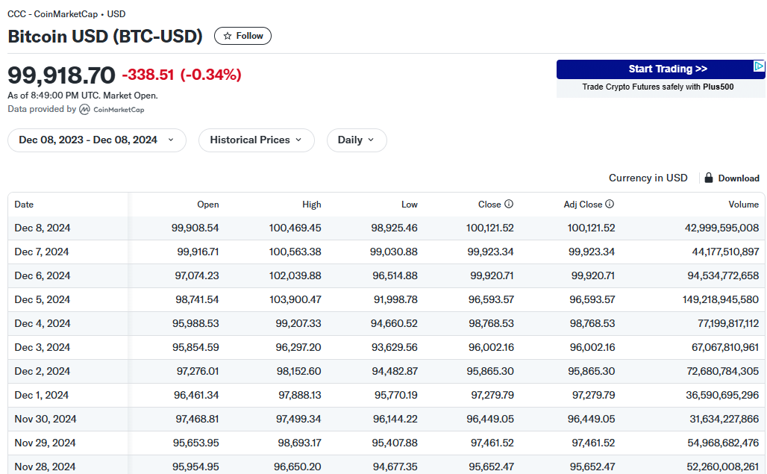
Business Understanding Contd.
Bitcoin pricing data
Available from Yahoo Finance
Rolling 5Y
Date, Open Price, High Price, Low Price, Adjusted Close Price, Close Price, Volume

Slide 6
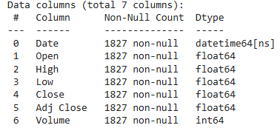
Exploratory Data Analysis
Basic EDA
Explored file to ensure accuracy, found 0 null entries, all 1827 rows were populated
All columns were data type ‘Float64’ except the date field which was data type ‘Date’
Visualized using a basic line graph of Bitcoin’s closing price over the 5 year scale
Coin grows rapidly during COVID, a bit of a stall in 2023, then roars towards 2025

Slide 7
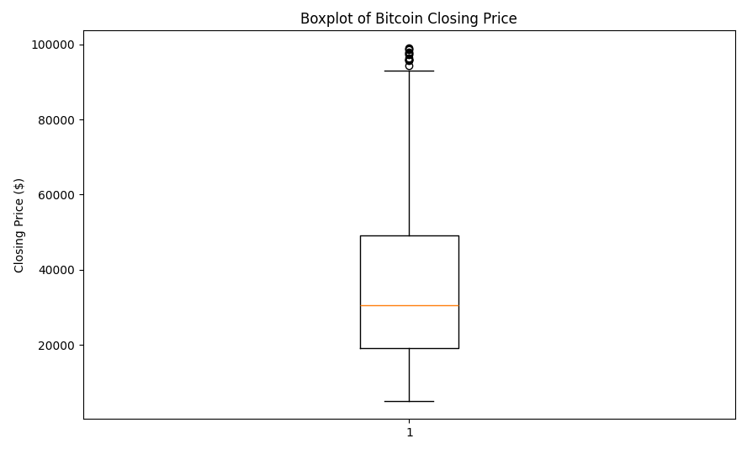
Exploratory Data Analysis Contd.
Explored the closing price further using a Box plot
Max. Value: $98,997
Median Value: $30,548.70
Mean Value: $34,970.53
75th Percentile: $49,031.46
25th Percentile: $19,244.45

Slide 8
Data Preparation/Feature Engineering
Due to the relatively clean data nature of Yahoo Finance, the process was very straightforward
Split the data into 80/20 test & train by date
80% Training
20% Testing
Allows 80% historical data to predict 20% “Future/Unseen” data
Applied the MinMax scaler to get the values on a 0-1 scale
Data was then clean enough for modeling!

Slide 9
Methodology & Tools
Hardware Support
Google Colab
CPU Accelerator
I began with a simple recurrent neural network (RNN)
Used the adam optimizer
Loss measure: Mean Square Error
Chosen for its ability to handle time-series data like stock market pricing
Recurrent feature allows for previous information to impact future prediction
I.E. value on Jan. 1 can impact value on Jan. 2 and so on
{Model Alpha}
RNN
20 epochs, batch size of 32

Slide 10
Methodology & Tools Contd.
Graduated to Long Short-Term Memory (LSTM) Model
A type of RNN
Significant for their structure including memory gates to allow for older historical data to have more impact
{Model Beta}
LSTM
50 epochs and batch size of 64
{Model Gamma}
LSTM
100 epochs, batch size of 64
{Model Delta}
LSTM
100 epochs, batch size of 128

Slide 11
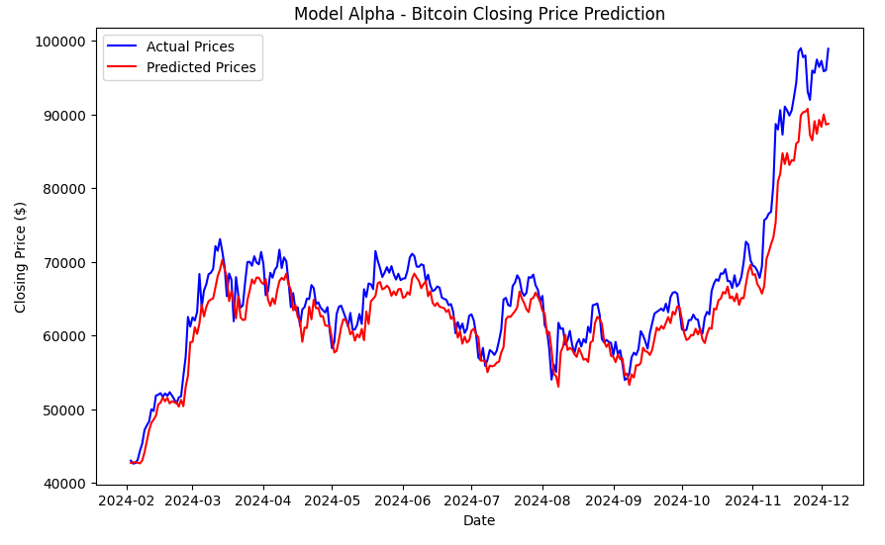

Model Evaluation (Model Alpha)
Model Alpha
20 epochs, batch size of 32
𝛼

Slide 12
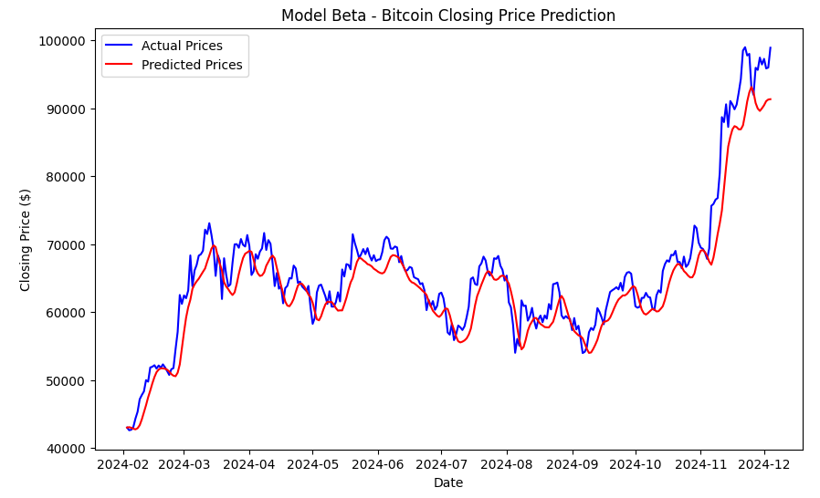
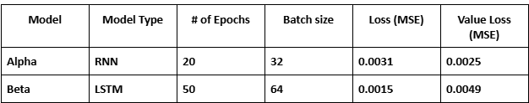
Model Evaluation (Model Beta)
Model Beta
50 epochs, batch size of 64
𝛽

Slide 13
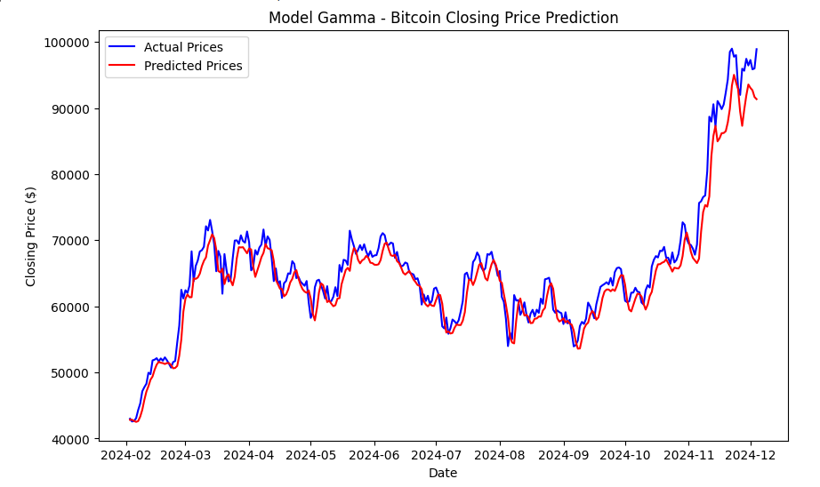
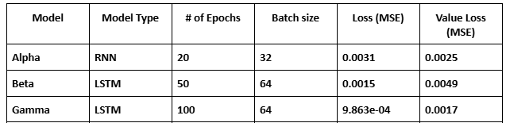
Model Evaluation (Model Gamma)
Model Gamma
100 epochs, batch size of 64
𝛤

Slide 14
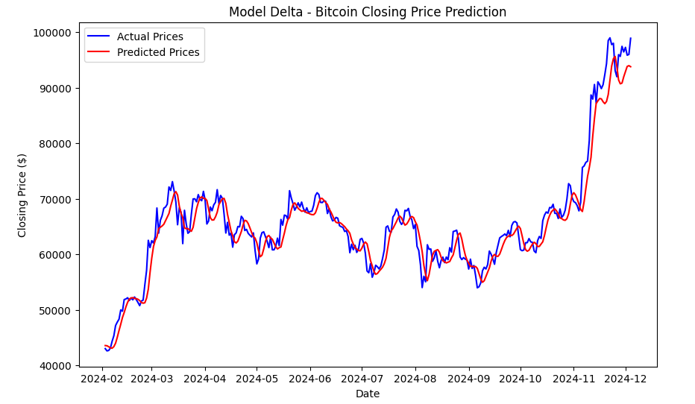
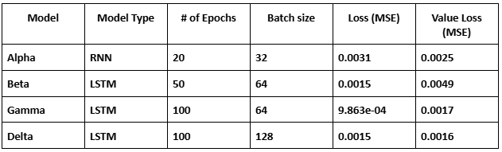
Model Evaluation (Model Delta)
Model Delta
100 epochs, batch size of 128
𝚫

Slide 15
Model Evaluation Overall
Model Gamma!
100 epochs, batch size of 64
RMSE Loss of 9.863e-4, Value Loss of 0.0017
Best overall model by Loss
𝛤

Slide 16
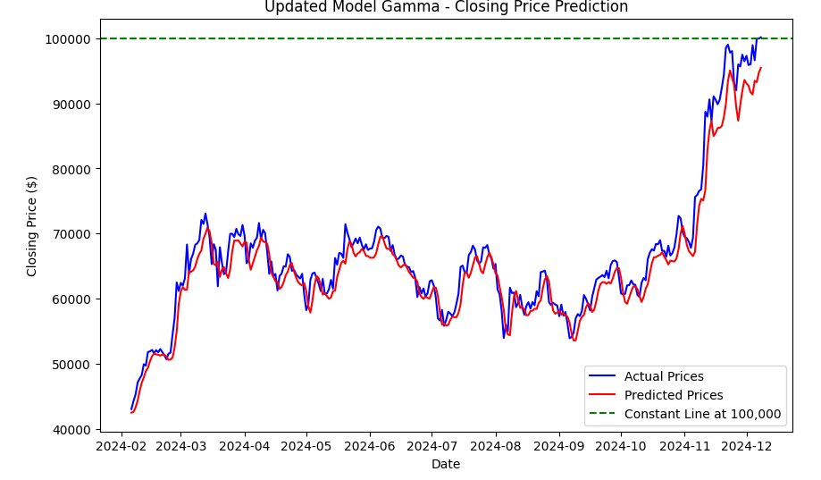
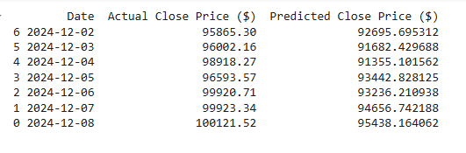
Model Evaluation Overall Contd.
Tested against new data - December 2, 2024-December 8, 2024
Actual Bitcoin Value crossed $100,000 on December 8, 2024
Predictor within ~$5,000
𝛤

Slide 17
Findings & Conclusions
Model Gamma was the winner!
When put to the test with real new data, the model predicted within ~$5,000 daily of the coin’s valuation
The model does support the business case
Allows investors to gain an indication of what the coin’s valuation will do on any given day
Assists investors decision making abilities
Can inform whether to sell a position or hold one in order to maximize earnings

Slide 18
Lessons Learned
Explore LSTM Models Right Away
Additional Hyper Parameter Tuning
Could Improve Accuracy by Bringing in Additional Datasets
Sentiment analysis of crypto-related conversations on Social Media
X
Threads
Facebook
Based on the sentiment, the coins valuation could sway above or below previously thought values
Test using alternate accelerators besides straight CPU acceleration
Reduce model building time
Build a model across more than 1 individual stock

Slide 19

Questions?

Slide 20
Appendix A
“Bitcoin USD (BTC-USD) Price History & Historical Data - Yahoo Finance.” Yahoo Finance, finance.yahoo.com/quote/BTC-USD/history/. Accessed 8 Dec. 2024.
Chaturvedi, Dr. Anil. “MSDS 422 - Practical Machine Learning.” 2024, Evanston, IL.
Fulton, RJ. “Prediction: Bitcoin Will Hit $100,000 before the End of the Year.” The Motley Fool, The Motley Fool, 29 Aug. 2024, www.fool.com/investing/2024/08/29/prediction-bitcoin-will-hit-100000-before-the-end/.
Idrees, Hassaan. “RNN vs. LSTM vs. GRU: A Comprehensive Guide to Sequential Data Modeling.” Medium, Medium, 5 July 2024, medium.com/@hassaanidrees7/rnn-vs-lstm-vs-gru-a-comprehensive-guide-to-sequential-data-modeling-03aab16647bb#:~:text=Architecture:,memory%20cell%20and%20hidden%20state.
“Satoshi Nakamoto Publishes a Paper Introducing Bitcoin | October 31, 2008.” History.Com, A&E Television Networks, 29 Oct. 2009, www.history.com/this-day-in-history/satoshi-nakamoto-publishes-a-paper-introducing-bitcoin.
“Tables and Figures.” APA Tables and Figures - Purdue OWL® - Purdue University, owl.purdue.edu/owl/research_and_citation/apa_style/apa_formatting_and_style_guide/apa_tables_and_figures.html. Accessed 8 Dec. 2024.

